Slide 1

Acquisition of Localization Confidence for Accurate Object Detection
Chen Jiayu
January 4, 2019

Slide 2
Contents
1. Motivation
2. Delving into object localization
3. IoU-Net
4. Experiments
5. Discussion

Slide 3

Motivation
1

Slide 4
The absent of localization confidence
two drawbacks
the suppression of duplicated detections is ignorant of the localization accuracy.
the absence of localization confidence makes the widely-adopted bounding box regression less interpretable.
Three contributions
Learning to predict IoU
IoU-guided NMS
Bounding box refinement as an optimization procedure

Slide 5
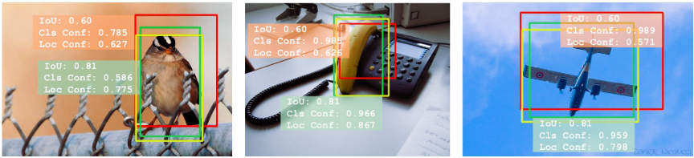
Bad money drives out good
Yellow bounding boxes: ground truth
Red and green bounding boxes: detected boxes

Slide 6
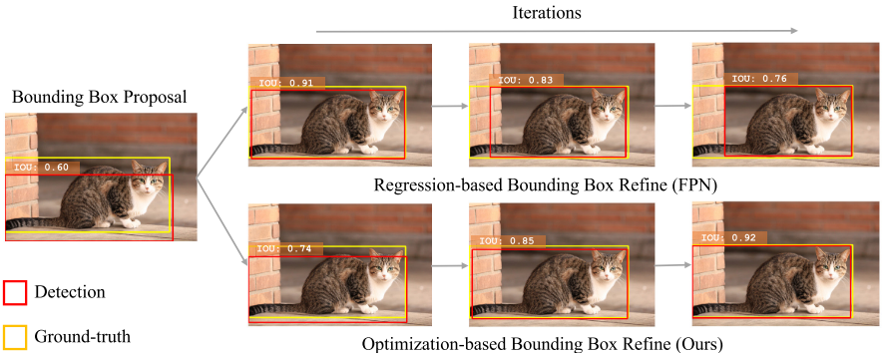
Non-monotonicity

Slide 7
Delving into object localization
2

Slide 8
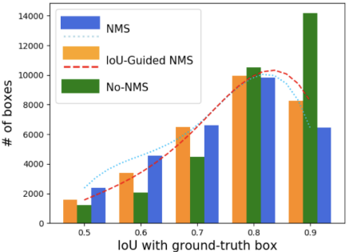
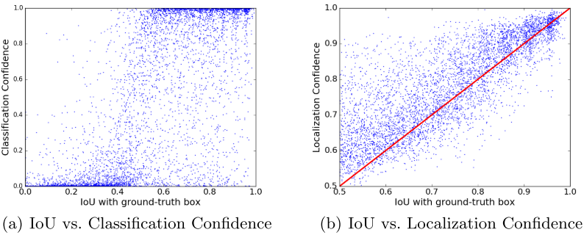
Misalignment
Pearson correlation coefficients are: (a) 0.217, and (b) 0.617
The difference between positive samples
No-NMS could be considered as the upper-bound for the number of positive bounding boxes.

Slide 9
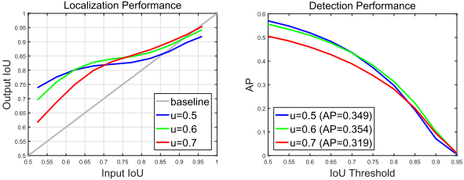
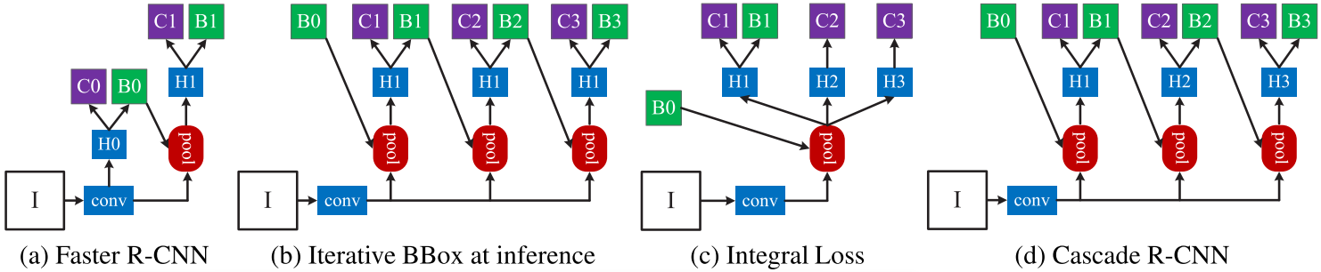
Cascade R-CNN

Slide 10
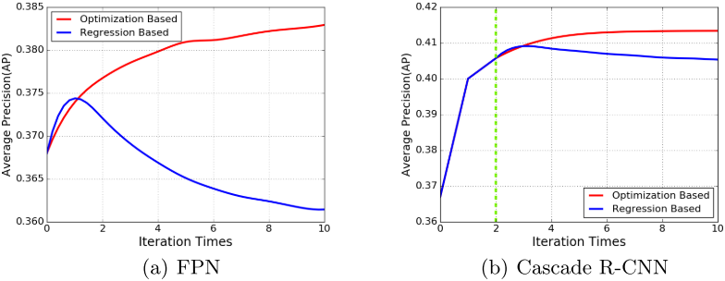
Non-monotonic
Regression Based
Non-monotonicity
Non-interpretability
Non-controllability
Optimization Based
Monotonicity
Interpretability
Controllability

Slide 11
IoU-Net
3

Slide 12
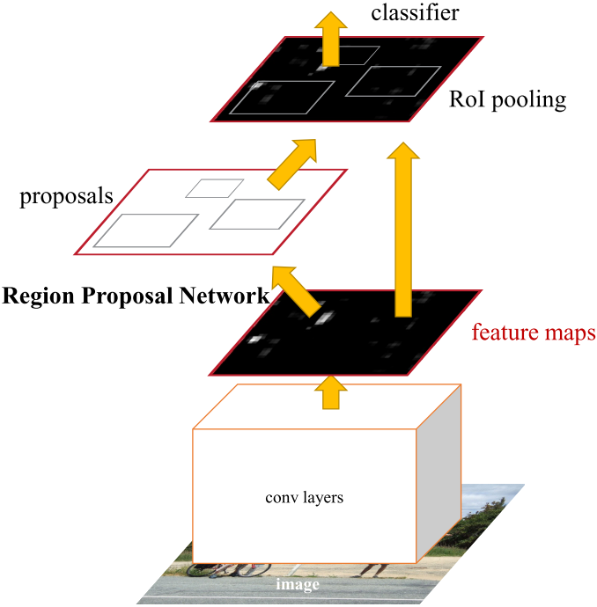
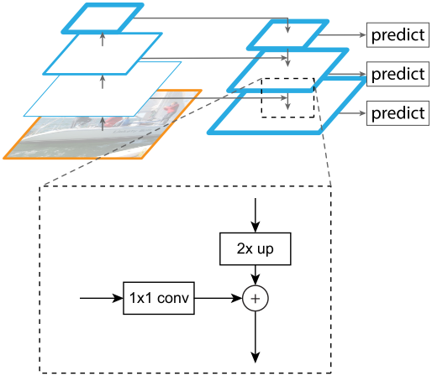
Faster R-CNN & FPN

Slide 13
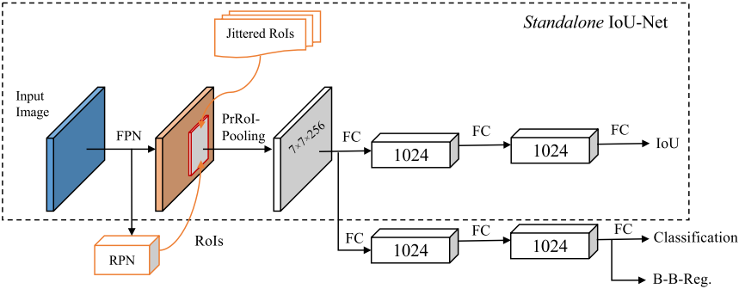
Learning to predict IoU
Differences:
IoU-Net branch
R-CNN branch

Slide 14
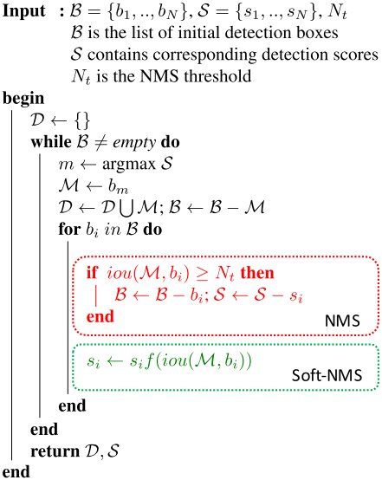
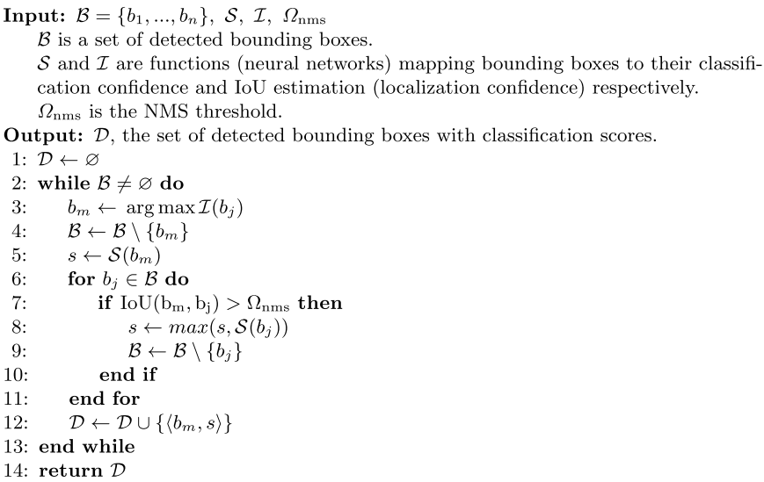
IoU-guided NMS
NMS&Soft-NMS
IoU-guided NMS

Slide 15
example
Iou:0.1
Score:0.6
Iou:0.1
Score:0.6
Pre-Iou:0.1
Score:0.6
Iou:0.9
Score:0.3
Iou:0.9
Score:0.3
Pre-Iou:0.9
Score:0.3
Iou:0.6
Score:0.9
Iou:0.6
Score:0.9
Pre-Iou:0.6
Score:0.9
Threshold:0.5
NMS
Soft-NMS
IoU-guided NMS
Iou:0.1
Score:0.6
Iou:0.1
Score:0.54
Pre-Iou:0.1
Score:0.6
Score:0.95
Iou:0.9
Score:0.03
Pre-Iou:0.95
Ori-score:0.5
Score:0.9
Iou:0.6
Score:0.36

Slide 16
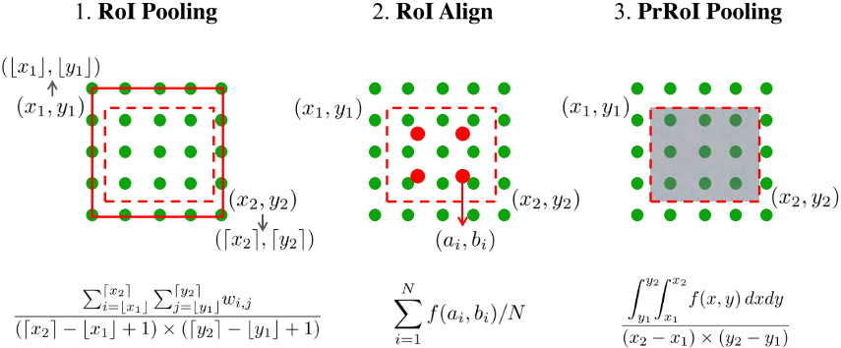

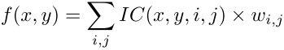
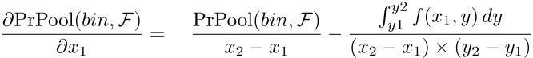
Precise RoI Pooling

Slide 17
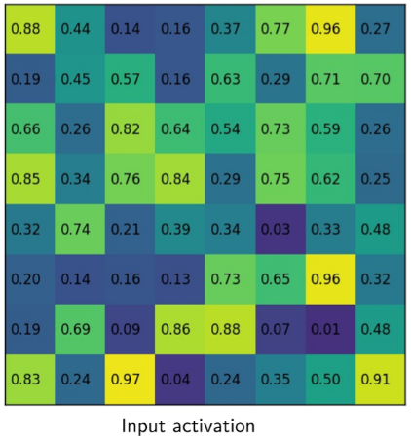
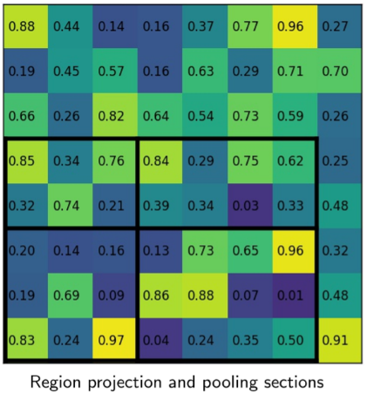
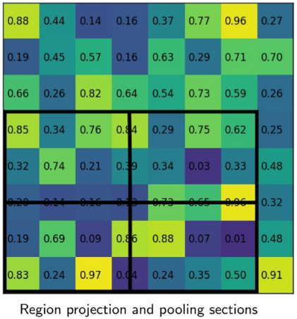
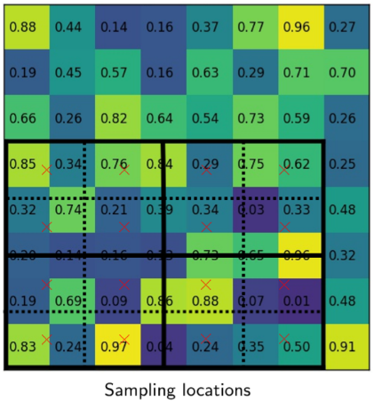
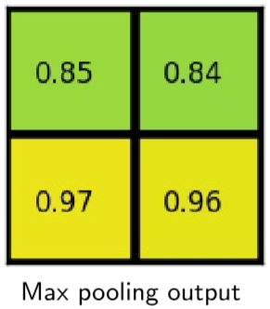
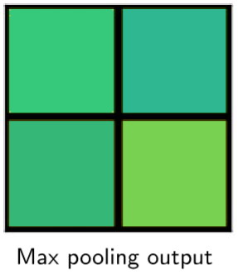
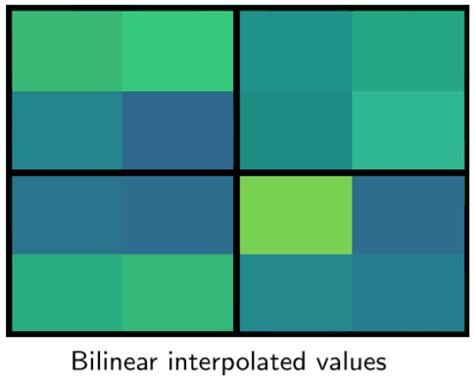
example
RoI Pooling
RoI Align

Slide 18
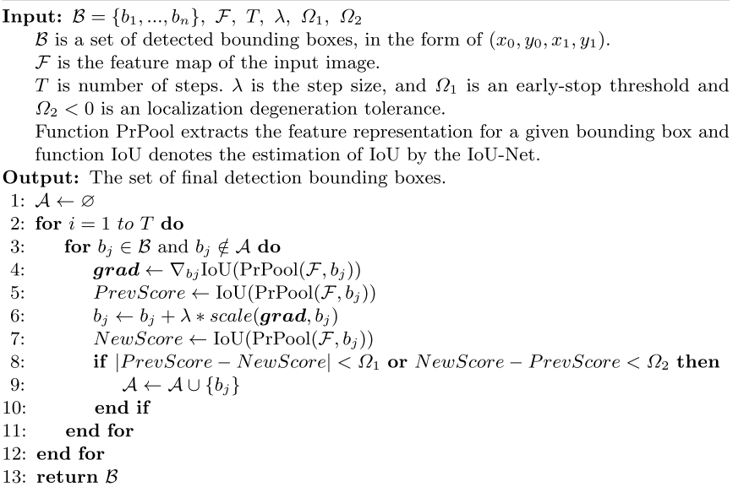
Bounding box refinement
Train:
Feature&Box coordinates -> Pooled feature -> Predicted IoU
Test:
Target max(Predicted IoU)
Feature&Detected box coordinates -> Pooled feature - > update coordinates -> loops -> Until the conditions are met

Slide 19
Joint training
Train:
Precise RoI Pooling layer
Parallel
IoU-Net branch
smooth-L1 loss
Training data
Normalization
Test:
initial coordinates
IoU-guided NMS
refinement

Slide 20
Experiments
4

Slide 21
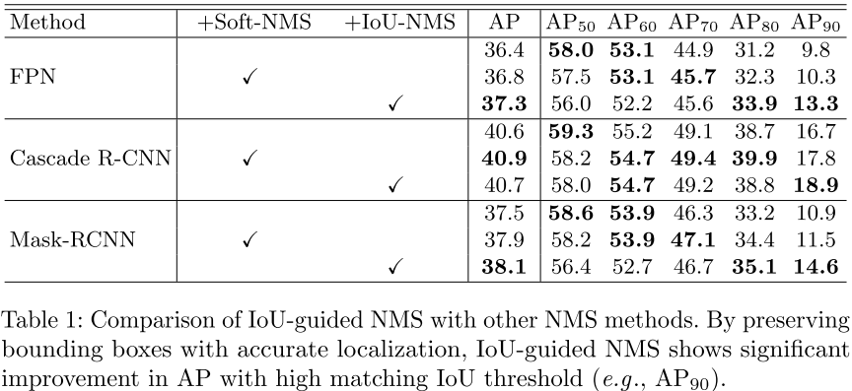
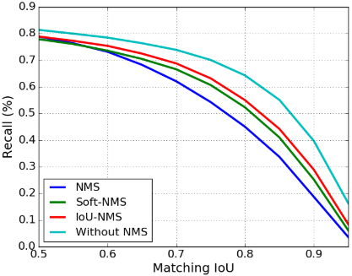
IoU-guided NMS
Low IoU metrics
High IoU metrics
No-NMS (no box is sup- pressed) is provided as the upper bound of the recall.

Slide 22
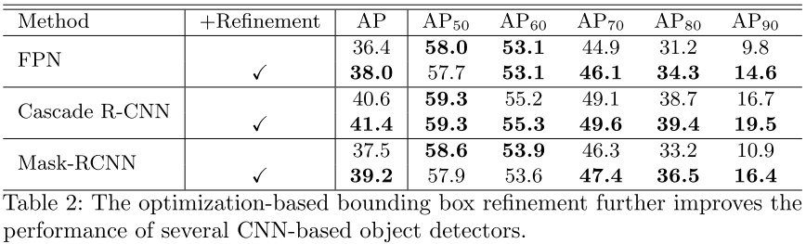
Refinement
Amazing!

Slide 23
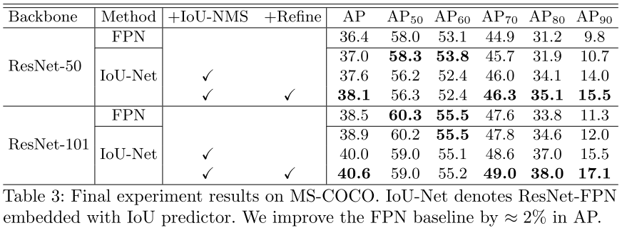
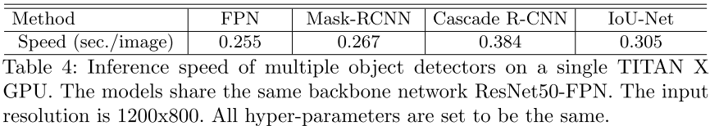
Joint training
Three kinds of strategy
IoU-Net
IoU-NMS
Refine
Tolerable computation overhead

Slide 24
Discussion
4

Slide 25
Discussion
What are the target of the IoU-Net branch during testing?
How is the training data of the IoU-Net branch generated?

Slide 26
THANKS

